Slide 1
Hazeley SEN Information Report: Information At A Glance
Who Do We Support?
Identifying A pupil With SEN
Supporting Our pupils And Extra Provision
We support pupils with a wide range of needs, including:
Communication and Interaction
Cognition and Learning
Social, Emotion and Mental Health difficulties
Sensory and/or
physical needs
We try and identify a pupil with SEN as soon as possible, by liaising with transition schools/ agencies, pupils, parents, professional agencies and staff.
If the child/young person has an Educational, Health and Care Plan (EHCP), parents/carers will be invited to an Annual Review, coordinated by the SENCo.
See a comprehensive list of provision by following the appropriate links:
Support in lesson
Interventions and mentoring
Highly qualified staff and training
Equipment and facilities
A range of clubs, including a SEN Homework Support Club
Supporting pupils to improve emotional and social development
Communicating with parents to review support plans
Click here for more information
Click here for more information
Ensuring Progress
Supporting Through Transition
Agencies To Support You And Your Child
Contact Us
We review pupils on a termly basis to evaluate progress and the effectiveness of interventions.
We also monitor class data to ensure a pupil is making progress in their subjects, and ask for feedback from staff, parents/carers, progress leaders and the pupil.
There are a range of procedures to support pupils joining and moving on from the Academy:
Collaborative planning meetings with Year 6 staff
Support from the 5D Transition Coordinator
Extra transition visits
and support
Additional career meetings
We work with a wide range of agencies to best support you and your child.
Other alternative support can be found at the Milton Keynes SEND Local Offer.
Head of School:
Miss Whiteman
SENCo: Miss Lord
Deputy SENCo:
Miss Brooks
Transition Coordinator:
Mrs Barstow-Nazli
Matron: Miss Winkfield
Head of Sixth Form:
Mr Kendall
Designated Safeguarding Lead: Mr Hall
Click here for more information
Click here for more information
Click here for more information
Click here for more information
Notes:
Readability

Slide 2
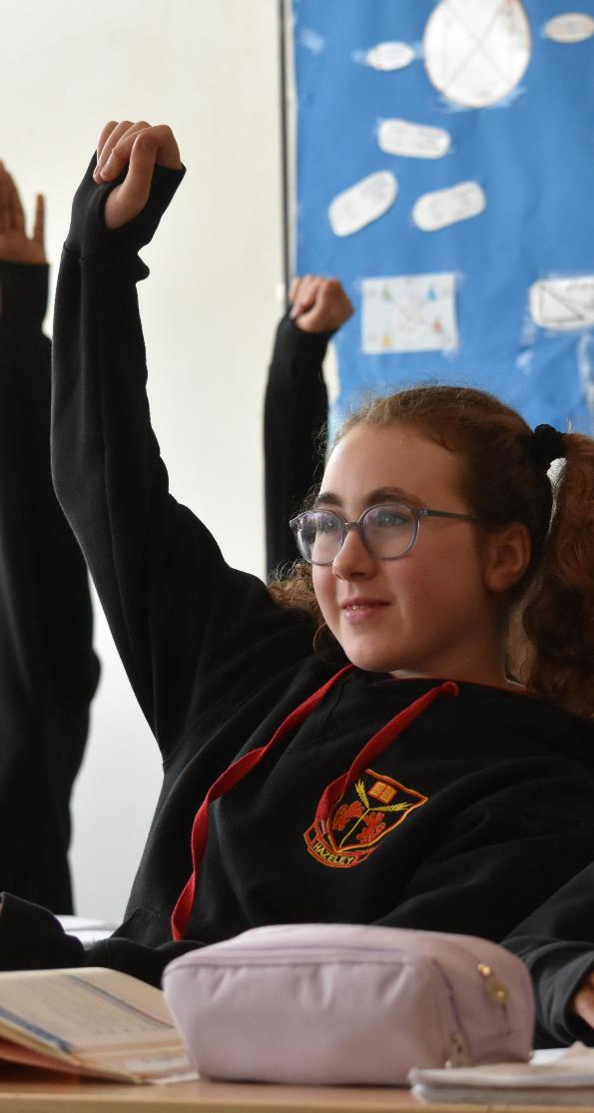
Who Do We Support?
S
Our Academy currently provides additional and/or different provisions for a range of needs, including:
Communication and Interaction e.g. Autism Spectrum Condition; Asperger’s Syndrome; speech and language difficulties
Cognition and Learning e.g. specific learning difficulties such as dyslexia; dyspraxia; dyscalculia
Social, Emotional and Mental Health (SEMH) difficulties e.g. Attention Deficit Hyperactivity Disorder (ADHD); anxiety
Sensory and/or Physical needs e.g. deaf/hard of hearing; visual impairments; processing difficulties; cerebral palsy

Slide 3

How Do We Identify If A Pupil Has SEN?
Identifying the needs of pupils
We liaise with transition schools or agencies to identify the support or provision previously in place for the child/young person.
We have early discussions to gather the views of the child/young person, parents/carers, and staff. We discuss the needs and identify the type of support that might be beneficial.
We liaise with external professionals to identify strategies, intervention and support that might be beneficial.
Consultations
Consultations primarily take place during Parents’ Evening and also Review meetings. These consultations ensure that:
Everyone develops a good understanding of the pupil’s area of strength and difficulty.
We consider any parent/carer concerns.
Everyone understands the agreed outcomes sought for the child/ young person.
Everyone is clear on what their next steps are.
These discussions are recorded and provided to parents/carers. We will then notify parents/carers when it is decided that a pupil will receive SEN support.
Notes:
281B

Slide 4

How Do We Identify If A Pupil Has SEN?
Supporting pupils
Where necessary, we update the Additional Needs Register and/or SEND Support Plan with support from all stakeholders, to review or set targets for a period and subsequently plan for support.
We inform all staff of Adaptive Teaching strategies or any identified interventions and expected outcomes.
Assessing a pupil's progress
The impact of the child’s/young person’s additional SEND support (whether it is classroom-based or within interventions) is evaluated at the end of an agreed period, and outcomes are used to inform future support.
If the child/young person has an Educational, Health and Care Plan (EHCP), parents/carers, and anyone involved in the support of the child/young person, will be invited to an Annual Review. This process is coordinated by the SENCo.
We have a process for all staff to refer any SEND-related concerns to the SEND department for review.
Notes:
281B

Slide 5

How Do We Support Your Child?
In Lessons
Teachers are responsible and accountable for the progress and development
of all the pupils in their class.
High-quality, adaptive teaching is our first step in responding to pupils
who have SEND. This will be differentiated for individual pupils.
We make the following adaptations to ensure all pupils’ needs are met, these consider the individual needs of the child/young person. Some of these include:
Adapting our curriculum to ensure all pupils can access it whilst maintaining high expectations e.g. by grouping; teaching style; content of the lesson; learning environment.
Adapting our resources and staffing, where necessary.
Using recommended aids e.g. assistive technology; visual timetables; larger fonts.
Adapting our teaching e.g. giving longer processing times; pre and post teaching of key vocabulary or concepts; reading instructions aloud etc.
Alternative curriculum pathways, and curriculum offer with greater emphasis on vocational employability skills, life and functional skills acquisition.

Slide 6
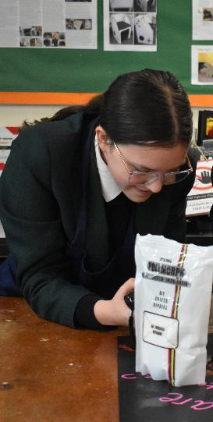
How Do We Support Your Child?
Interventions/Additional Support For Learning
We provide continuous professional development to develop our staff
in a range of specialisms. Interventions we currently provide include:
EAL (English as an Additional Language) Intervention.
Talk About Social Skills development through interpersonal communication.
Living Life To The Full, talking Cognitive Behavioural Therapy(CBT).
Small group interventions to provide additional literacy and numeracy intervention to support catch-up; pre or post teaching; basic skills support; GCSE-level support.
Guided reading.
Phonics (Fresh Start) Intervention.
Handwriting intervention
Touch-typing interventions.
Mentoring in a range of areas.
Adaptations, visual impairment (VI) and Deaf/Hard of hearing
(HI) support.
Access arrangements support e.g. extra time, scribe, reader
Emotional literacy.
Zones of regulation.

Slide 7
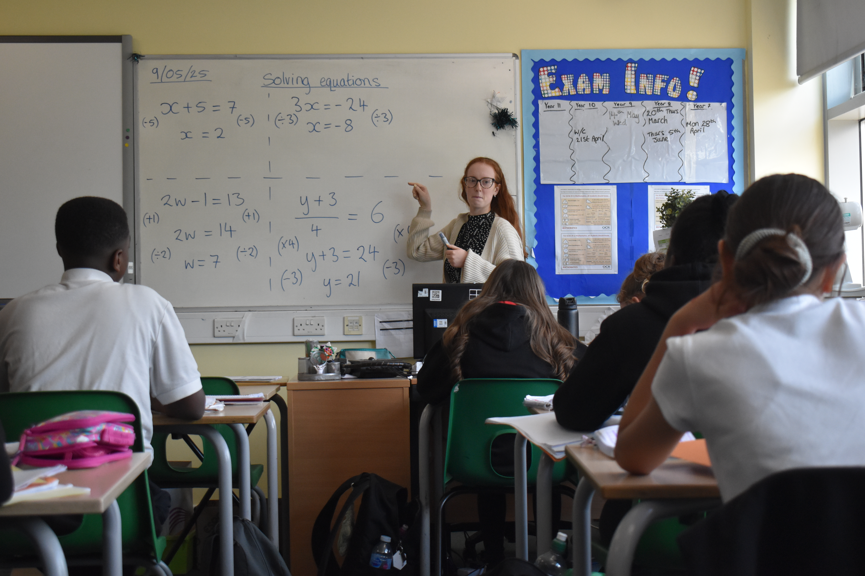
How Do We Support Your Child?
Staff Expertise
At The Hazeley Academy, we have two qualified SENCos within the setting that hold different roles with varying expertise and we currently have three members of staff undergoing the qualification.
The SENCo has four years’ experience in the role, previously being the Deputy SENCo at the Academy, and has been the lead on SEND Transition; working with the MK SEND Team; and feeder schools across West Milton Keynes. The SENCo helps co-ordinate staff training sessions across the year to help support pupils.
The SENCo is allocated 100% of the timetabled week to manage SEND provision. The Deputy SENCo has five hours allocated across the fortnight to perform SEND-related activities.
As of September 2025, we have a team of support staff comprised of four Team Leaders responsible for key areas; two Behaviour Coaches; one SEND Coordinator, three Higher Level Teaching Assistants (HLTA); a specialist VI Teaching Assistant; a specialist HI Teaching Assistant and 11 Teaching Assistants all with relevant training in a range of areas and delivering interventions. We also have a SEND Transition Lead supporting SEND pupils in the local area to have a smooth transition into secondary school.

Slide 8
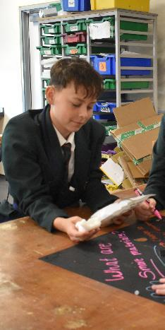
How Do We Support Your Child?
Equipment And Facilities
The Hazeley Academy works closely with the local authority to acquire specialist assistive equipment needed for our pupils to be able to access the curriculum.
Within the Academy, we have facilities that support a range of needs such as:
Alternative curriculum base, with specialised life skills resources.
A designated learning zone for English and Maths interventions.
Small-group intervention rooms.
Assistive equipment such as
laptops or reading pens.
A sensory room.
The Academy is accessible to wheelchair users and others with a range of needs. Facilities include:
Electronically controlled doors in corridors allowing fire doors to remain open.
The ability to have raised tables
in all mainstream classrooms.
Alternative methods of communication
with home available on request.
Dedicated disabled toileting facilities, including
a shower (no hoisting facilities).
Highlighted steps on key staircases.
Signage designed to support those with
visual impairment needs.
Lift and Evac Chairs.
Colour-coded subject areas.
Height-adjustable furniture in science laboratories, IT and technology classrooms.
Ability to adjust height of desks in all subjects.

Slide 9
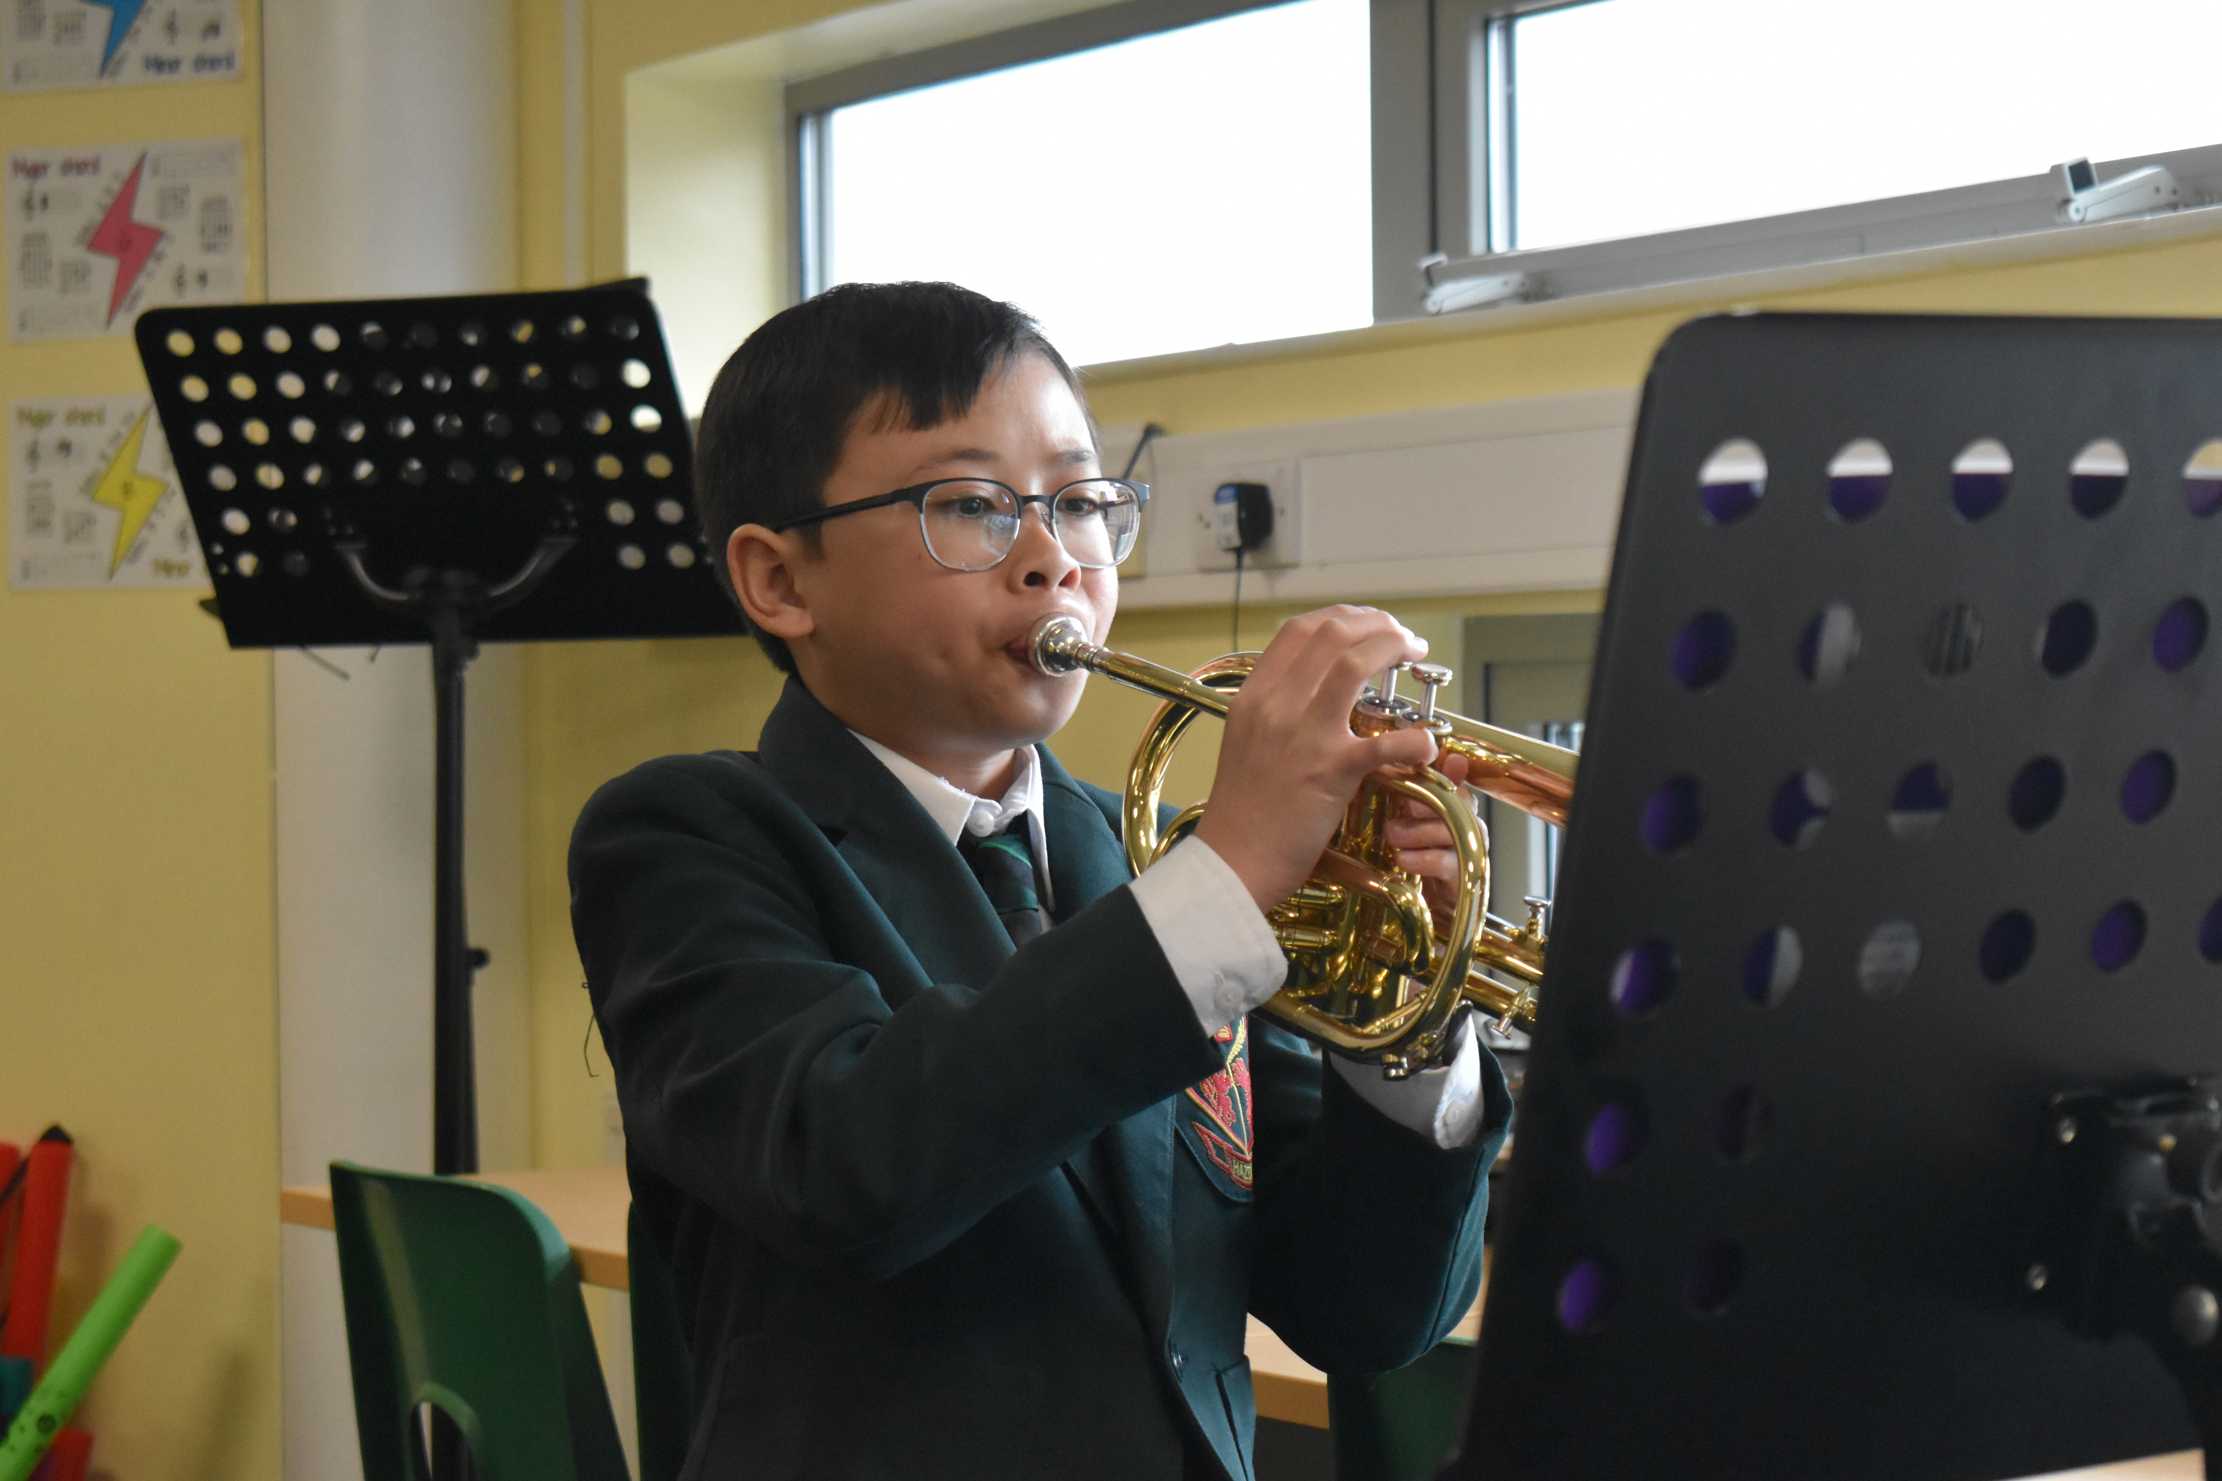
How Do We Support Your Child?
Back to contents
Supporting Emotional And Social Development
The Hazeley Academy provides support for all pupils (including those with SEND) to improve their emotional and social development in the following ways:
All pupils are encouraged to be part of the school council.
All pupils are encouraged to be part of the Equality Group.
All pupils are encouraged to be Mental Health Ambassadors or pupil buddies.
All pupils are supported via the Pastoral Team within the Academy.
Sixth Form pupils to be peer mentors.
Where necessary, those with identified needs are supported through social skills interventions and the school counselling service.
The SEND team work closely with the Personalisation team within the school to support the emotional and social development of SEND children and young people.

Slide 10

How Do We Support Your Child?
Communicating With Parents And Reviewing Our Support Plans
Any reviews and updates to a pupil’s support plan will always be communicated home to the parents/carers. This may be because:
A child/young person with an EHCP will have an Annual Review meeting; nature of ongoing support; outcomes in consultations with parents/carers, the pupil and relevant external agencies are reviewed.
A child/young person with a SEND support plan will have a review within the agreed period; targeted interventions, progress, and outcomes
are agreed with parents/carers and the pupil.
Parents’ Evenings focus on the curriculum being studied and a pupil’s progress within individual subjects; staff will provide information on how parents/carers can support their child/young person’s learning.
Regular progress and review information is shared with all parents/carers; the information is evaluated by the Academy to help identify any concerns regarding a child/young persons’ progress; where there are concerns, these are shared with parents/carers.

Slide 11
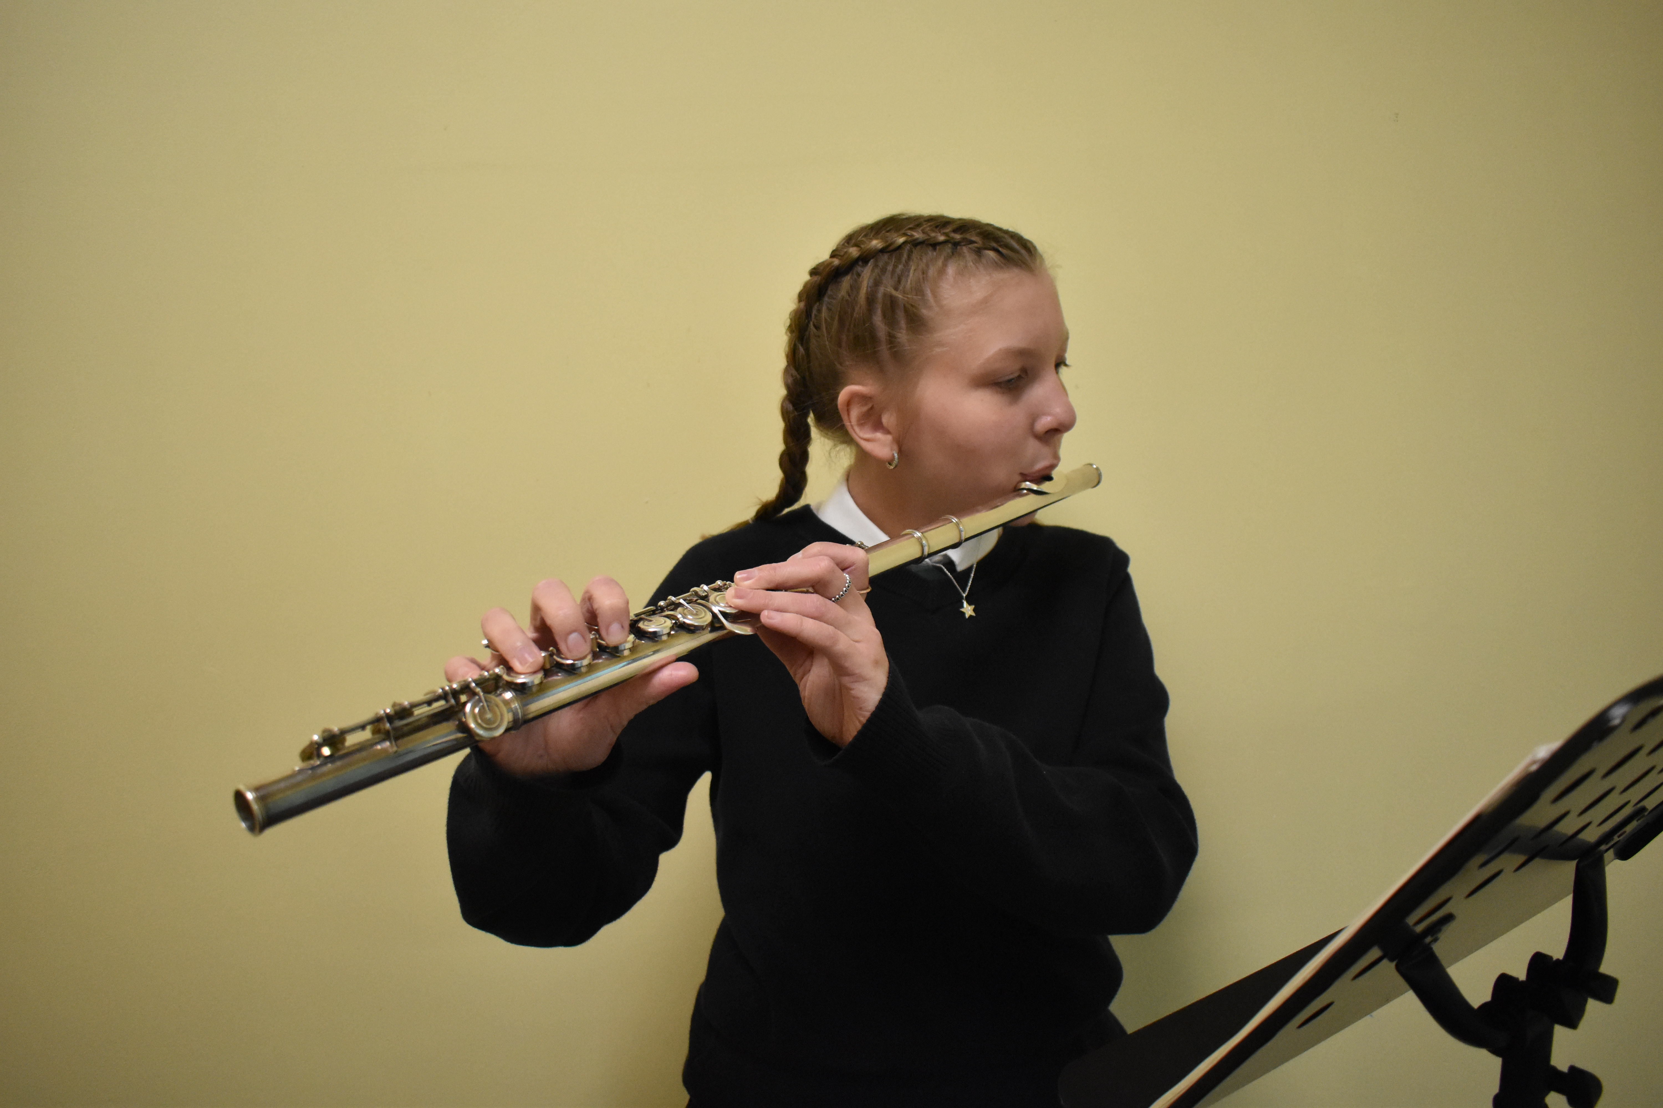
How Do We Ensure That Your Child Makes Progress?
The Hazeley Academy is committed to providing an effective provision for the children and young people that attend the Academy. We evaluate the effectiveness of provision for pupils with SEND by:
Reviewing progress and intervention effectiveness
Using pupil and parent/
carer feedback.
Using intervention trackers and provision maps to measure progress and
cost effectiveness.
Formative and summative assessments.
Observations.
SEN Reviews
Holding annual reviews for pupils having an EHCP (Educational, Health and Care Plan).
Termly reviews for all SEND pupils to monitor progress and adapt support accordingly.
Annual review of the SEND provision through internal and external audited reviews.
Annual reporting to the Local Governing Body on SEND provision
We follow the graduated approach and the four areas of the cycle which are: Assess, Plan, Do and Review. Subject teachers, progress leaders, the SENCo and others involved in the review of the child/young person, carry out a clear analysis of a pupil’s needs. The assessment will be reviewed regularly, at least once per term.

Slide 12
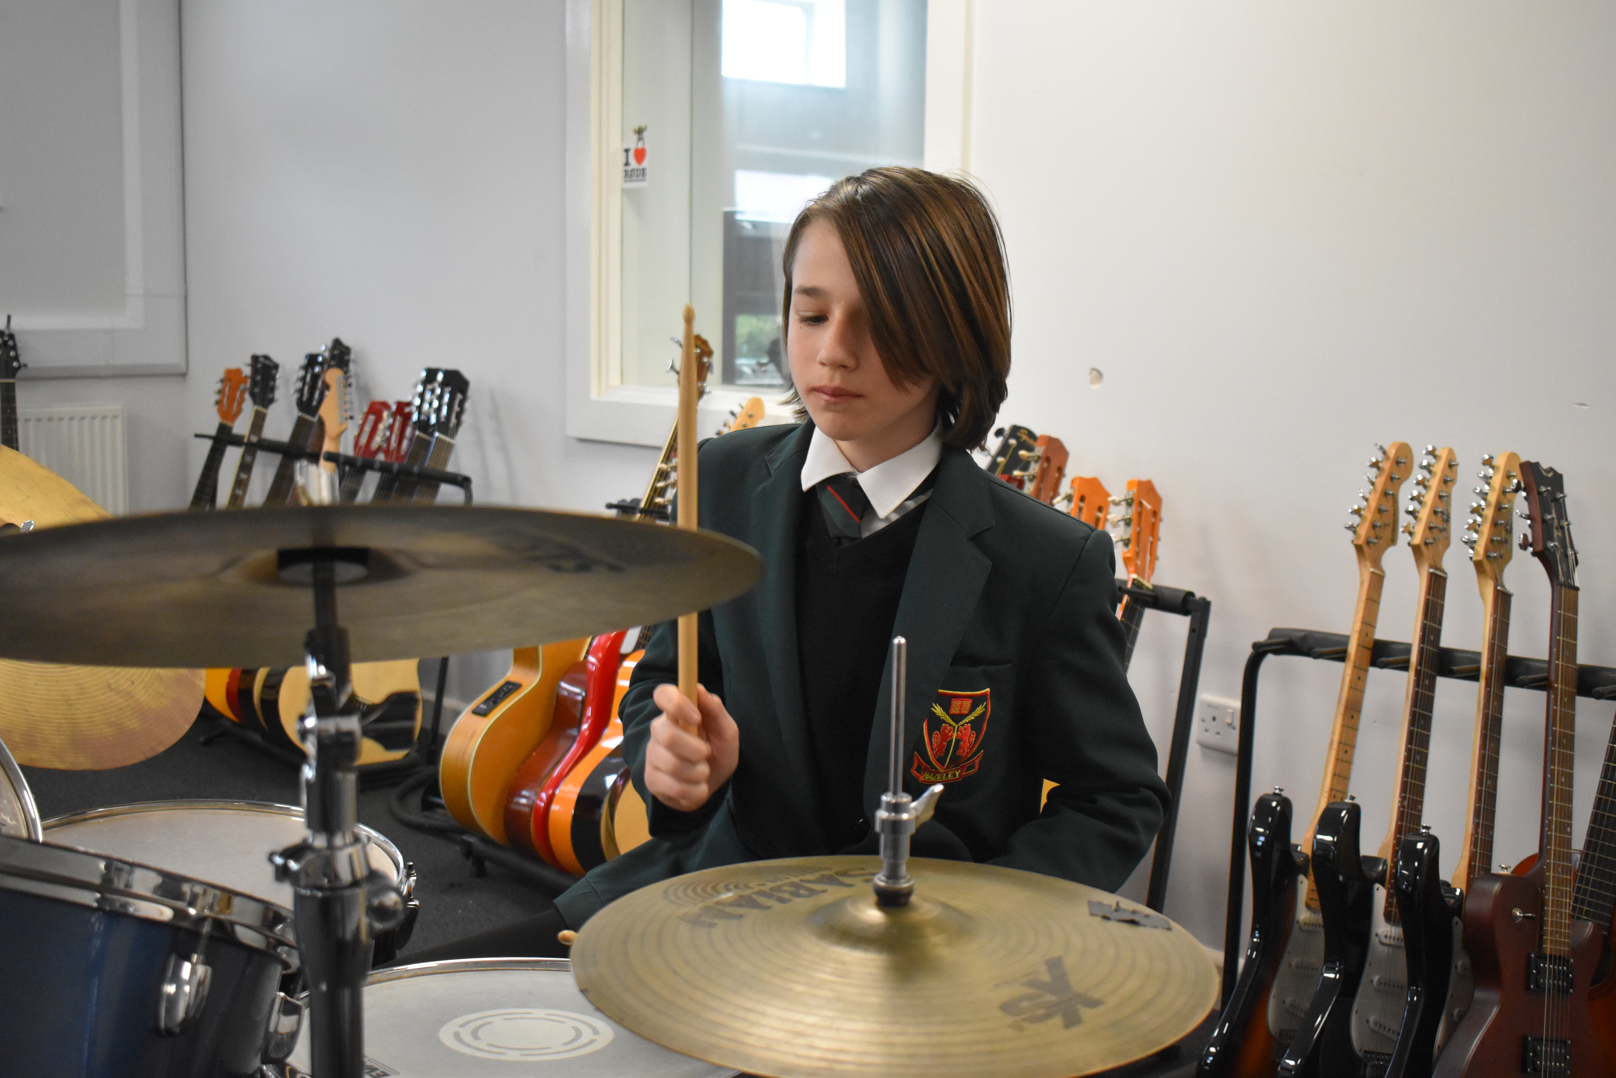
Supporting Students In, Through and Beyond The Hazeley Academy
We prepare and support pupils for joining and moving on from
the Academy through a range of procedures. These include:
Collaborative planning meetings with Year 6 colleagues.
Advice and support from the 5D Trust Transition SENCo prior
to and during transition, where relevant.
Opportunities for parents/carers to discuss their child’s SEND, EHCP or additional support needs with the SENCo prior to transfer.
Opportunities for additional transfer visits.
Consultation with specialist services before and during transition.
Advice and guidance for staff on pupils’ additional needs
prior to transfer.
Information, advice and guidance meetings for pupils.
Additional support with post-Year 11 applications and transfer visits.
Additional support for transfer from Year 11 into
the Academy’s Sixth Form.
Additional career meetings for pupils, where necessary.
Key transition Year group parents/carers and pupils are
invited to Transition events.
Beyond Year 11 event for our KS4 SEND pupils, providing them with an opportunity to meet with post-16 providers such as MK College, Moulton College, Stephenson, Sofea, The Christian Foundation etc.

Slide 13

The Agencies We Work With
To Support Your Child
The Academy is committed to developing professional working relationships with all agencies in support of all its pupils. We work with a range of specialist services, and this is done through a system of referral. These include (but are not limited to):
Milton Keynes SEND Team.
Educational Psychology Service.
Child Adolescent Mental Health Service (CAMHS).
Speech And Language Therapy (SALT) Service.
Occupational Therapy Service.
Physiotherapy Service.
Inclusion and Intervention Team.
Children and Family Practices.
Specialist Teacher for vision and hearing impairment.
The NHS, including the School Nurses Team and NHS
Complex Needs Nursing Team.
Children Services: Children with Disabilities Team.
Social Services.
Milton Keynes SEND Information, Advice and Support Service (SENDIAS) is a free service offering confidential and impartial information, advice and support to children and young people with additional needs and their parents/carers. Its remit covers education, health and social care between birth and 25 years of age.
Alternative support can be found at Milton Keynes SEND Local Offer.

Slide 14
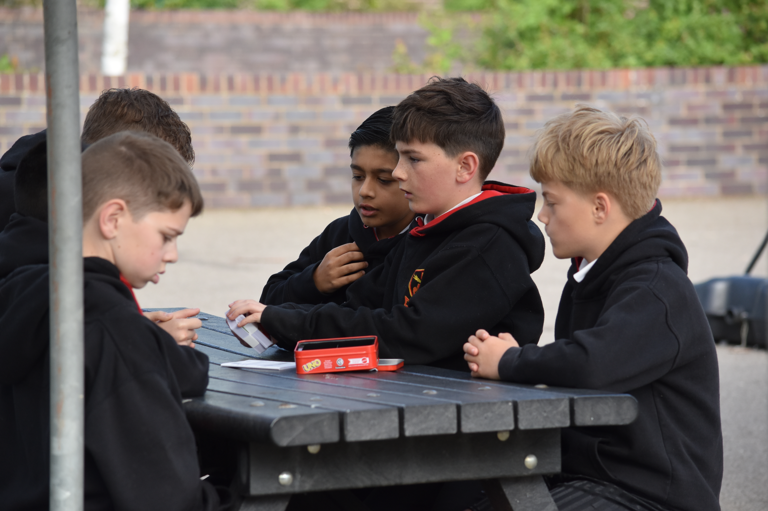
Contact And Communication Information
The Hazeley Academy takes complaints very seriously. We are committed to working closely with parents/carers. Any member of staff can be contacted to raise a concern. This includes:
Head of School: Miss Toni Whiteman
SENCo: Miss Natalie Lord
Deputy SENCo: Miss Beth Brooks
Transition Coordinator:
Mrs Maria Barstow-Nazli
Matron: Miss Sarah Winkfield
Head of Sixth Form: Mr Joe Kendall
Designated Safeguarding Lead:
Mr Richard Hall
However, in the first instance, complaints about the SEND provision at the Academy should be made to the Form Tutors.
Where a member of staff is unable to provide the information required, they will support the parents/carers to contact the appropriate person. The parent/carer will also be referred to the Academy’s Complaints Policy.
The parents/carers of pupils with disabilities have the right to make disability discrimination claims to the first tier SEND tribunal if they believe that the Academy has discriminated against their child. They can make a claim about alleged discrimination regarding:
Exclusions.
Provision of education or associated services.
Making reasonable adjustments, including the provision of auxiliary aids and services.

